Slide 1


Sequoia Financial Group Introduction
Welcome [INSERT ADVISOR NAME]
Updated 6.14.2023
INTEGRITY | PASSION | TEAMWORK

Slide 2
TABLE OF CONTENTS
3 …………………………………………………………………. Introduction to Sequoia
24……………………………………………..…………….. Wealth Planning Department
35……………………………………………………….. Asset Management Department
42………………………………………………………………………………...Compliance
45…………………………………………………………………………………..Marketing
50……………………………………………………………….……Building Opportunities
54……………………………………………………………..Important Facts for Advisors
62………………………………………………………………………Our Capital Partners
66…………………………………………………………………………………Vision 2030

Slide 3
Introduction

Slide 4
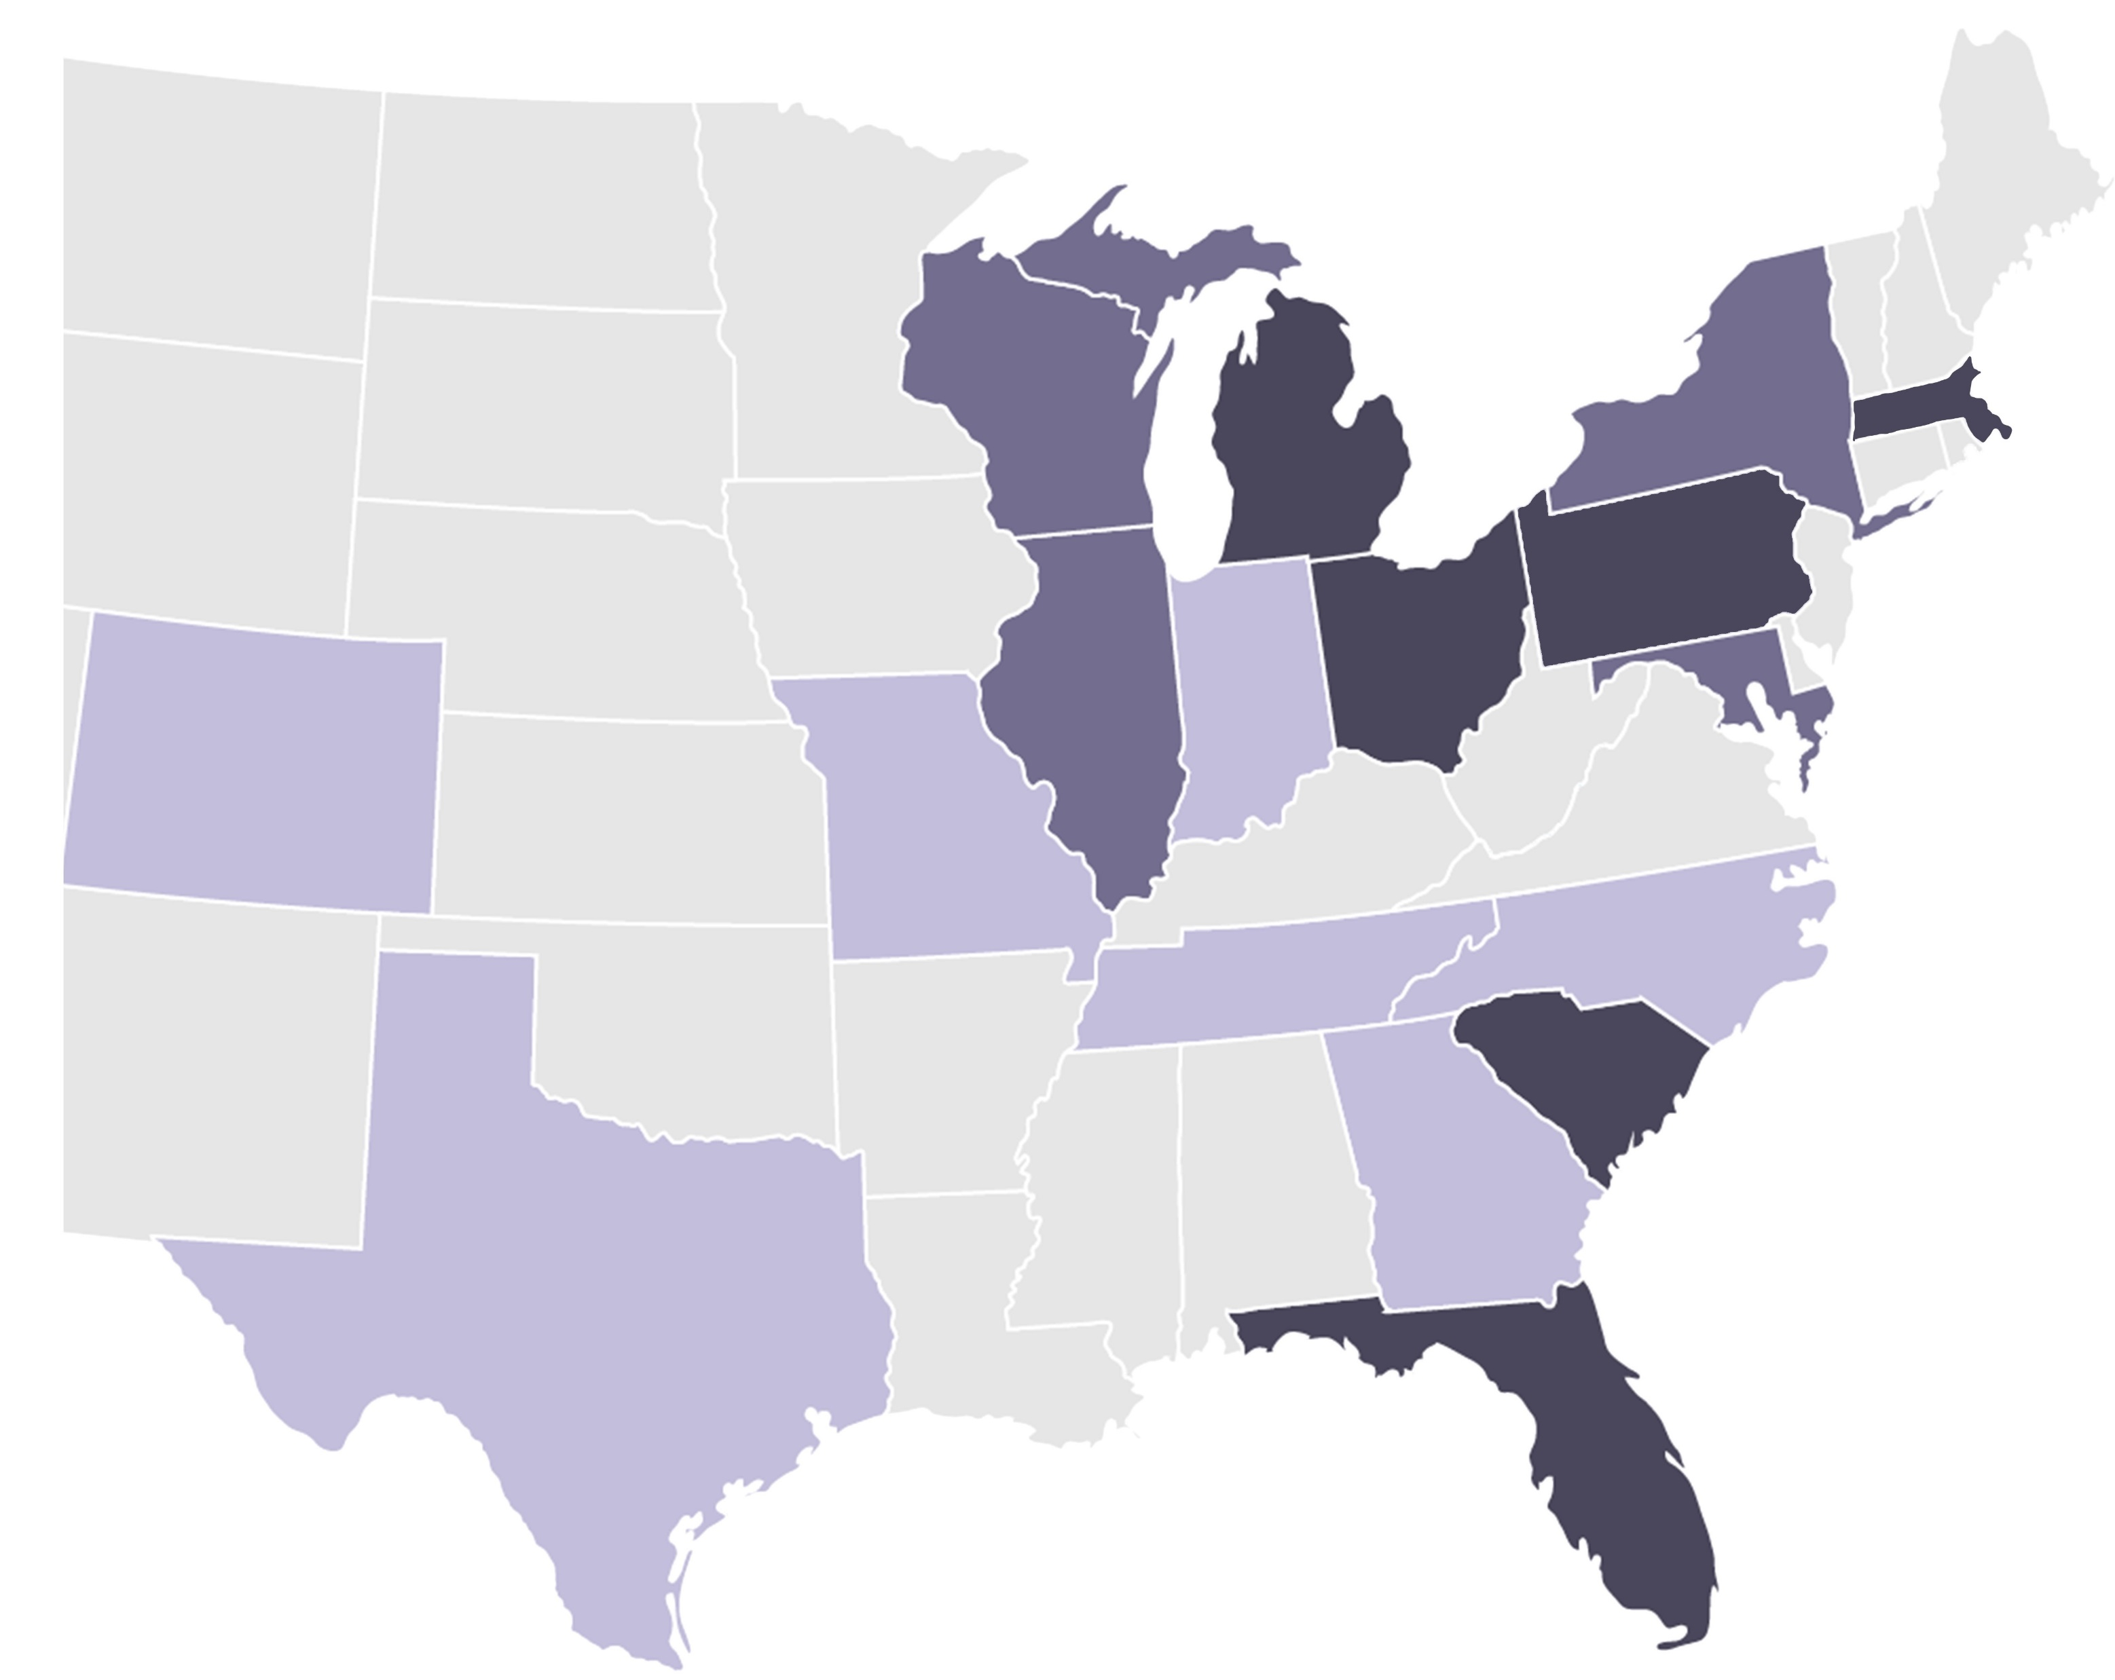
OUR SEQUOIA JOURNEY
SEQUOIA HAS BUILT A LEADING RIA PLATFORM IN THE MIDWEST OVER THE LAST 31 YEARS…
Sequoia Has Built A Leading RIA Platform In The Midwest Over The Last 31 Years…
… And Is Primed To Expand Over Its Next Phase Of Growth
Sequoia Footprint
Cohen & Company Locations
Targeted Growth Areas
1990s:
Entrepreneurial Origins
2000s:
Talent & Business Model Build
Mayfield Heights, OH
Burlington, MA
Served private business owners with complex balance sheets and developed internal corporate structure
Developed a relationship with Cohen & Company, who acquired an equity stake in 1999
Developed apprentice talent development model and trained many future leaders of the firm
Experimented with multiple service offerings to refine private client model
Executed first M&A transaction in ‘09
Cleveland, OH
Beachwood, OH
Troy, MI
St. Claire Shores, MI
Berwyn, PA
Columbus, OH
Akron, OH
2010s:
B2B and M&A Focus
2020s and Beyond:
Growth and Scale
Made large investments in infrastructure along with building out M&A and B2B strategies
Approved for SAN in 2010 and WAS in 2019
~$5MM+ in technology investments over 5 years
Partnered with Valeas Capital Partners as a long-term, strategic capital partner to accelerate growth and provide broader access to resources
Refined organization to prepare for further scale organically and via M&A
Tampa, FL
Hilton Head, SC

Slide 5



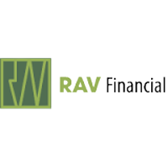








M&A
History
Redhead Financial Group Founded 1993 I Acquired 2009
Hammerman & Strickland Founded 1993 I Acquired 2012 I Florida
RAV Financial Founded 1982 I Acquired 2016
GHD Wealth Management Founded 1998 I Acquired 2016
LJPR Financial Advisors Founded 1989 I Acquired 2018
WEALTHSTONE Advisors Founded 1977 I Acquired 2021
NCA Financial Planners Founded 1986 I Acquired 2021
Zeke Capital Advisors Founded 2008 I Acquired 2023
Cirrus Wealth Management Founded 2015 I Acquired 2023
Affinia Financial Group Founded 2019 I Acquired 2023
We are a collection of the best pieces of 11 firms.
We choose to partner with successful firms who persevere.

Slide 6
CLIENT FOCUS– PRE MERGER
City | Financial Advisory | Private Client | Private Wealth | Family Wealth | Family Office | Specialty / Resource Group
Tampa, FL | ✓ | ✓ | ✓
Lutz, FL | ✓ | ✓ | ✓ |  |  | ✓ (Military)
Beachwood, OH | ✓ | ✓ | ✓ |  |  | ✓ (Physicians)
St. Claire Shores, MI | ✓ | ✓ | ✓
Troy, MI | ✓ | ✓ | ✓ |  |  | ✓ (Guns N’ Hoses)
Columbus, OH |  | ✓ | ✓ | ✓
Mayfield, OH | ✓
Berwyn, PA |  |  |  | ✓ | ✓
Independence, OH | ✓ | ✓
Burlington, MA | ✓ | ✓ |  |  |  | ✓ (Special needs)

Slide 7








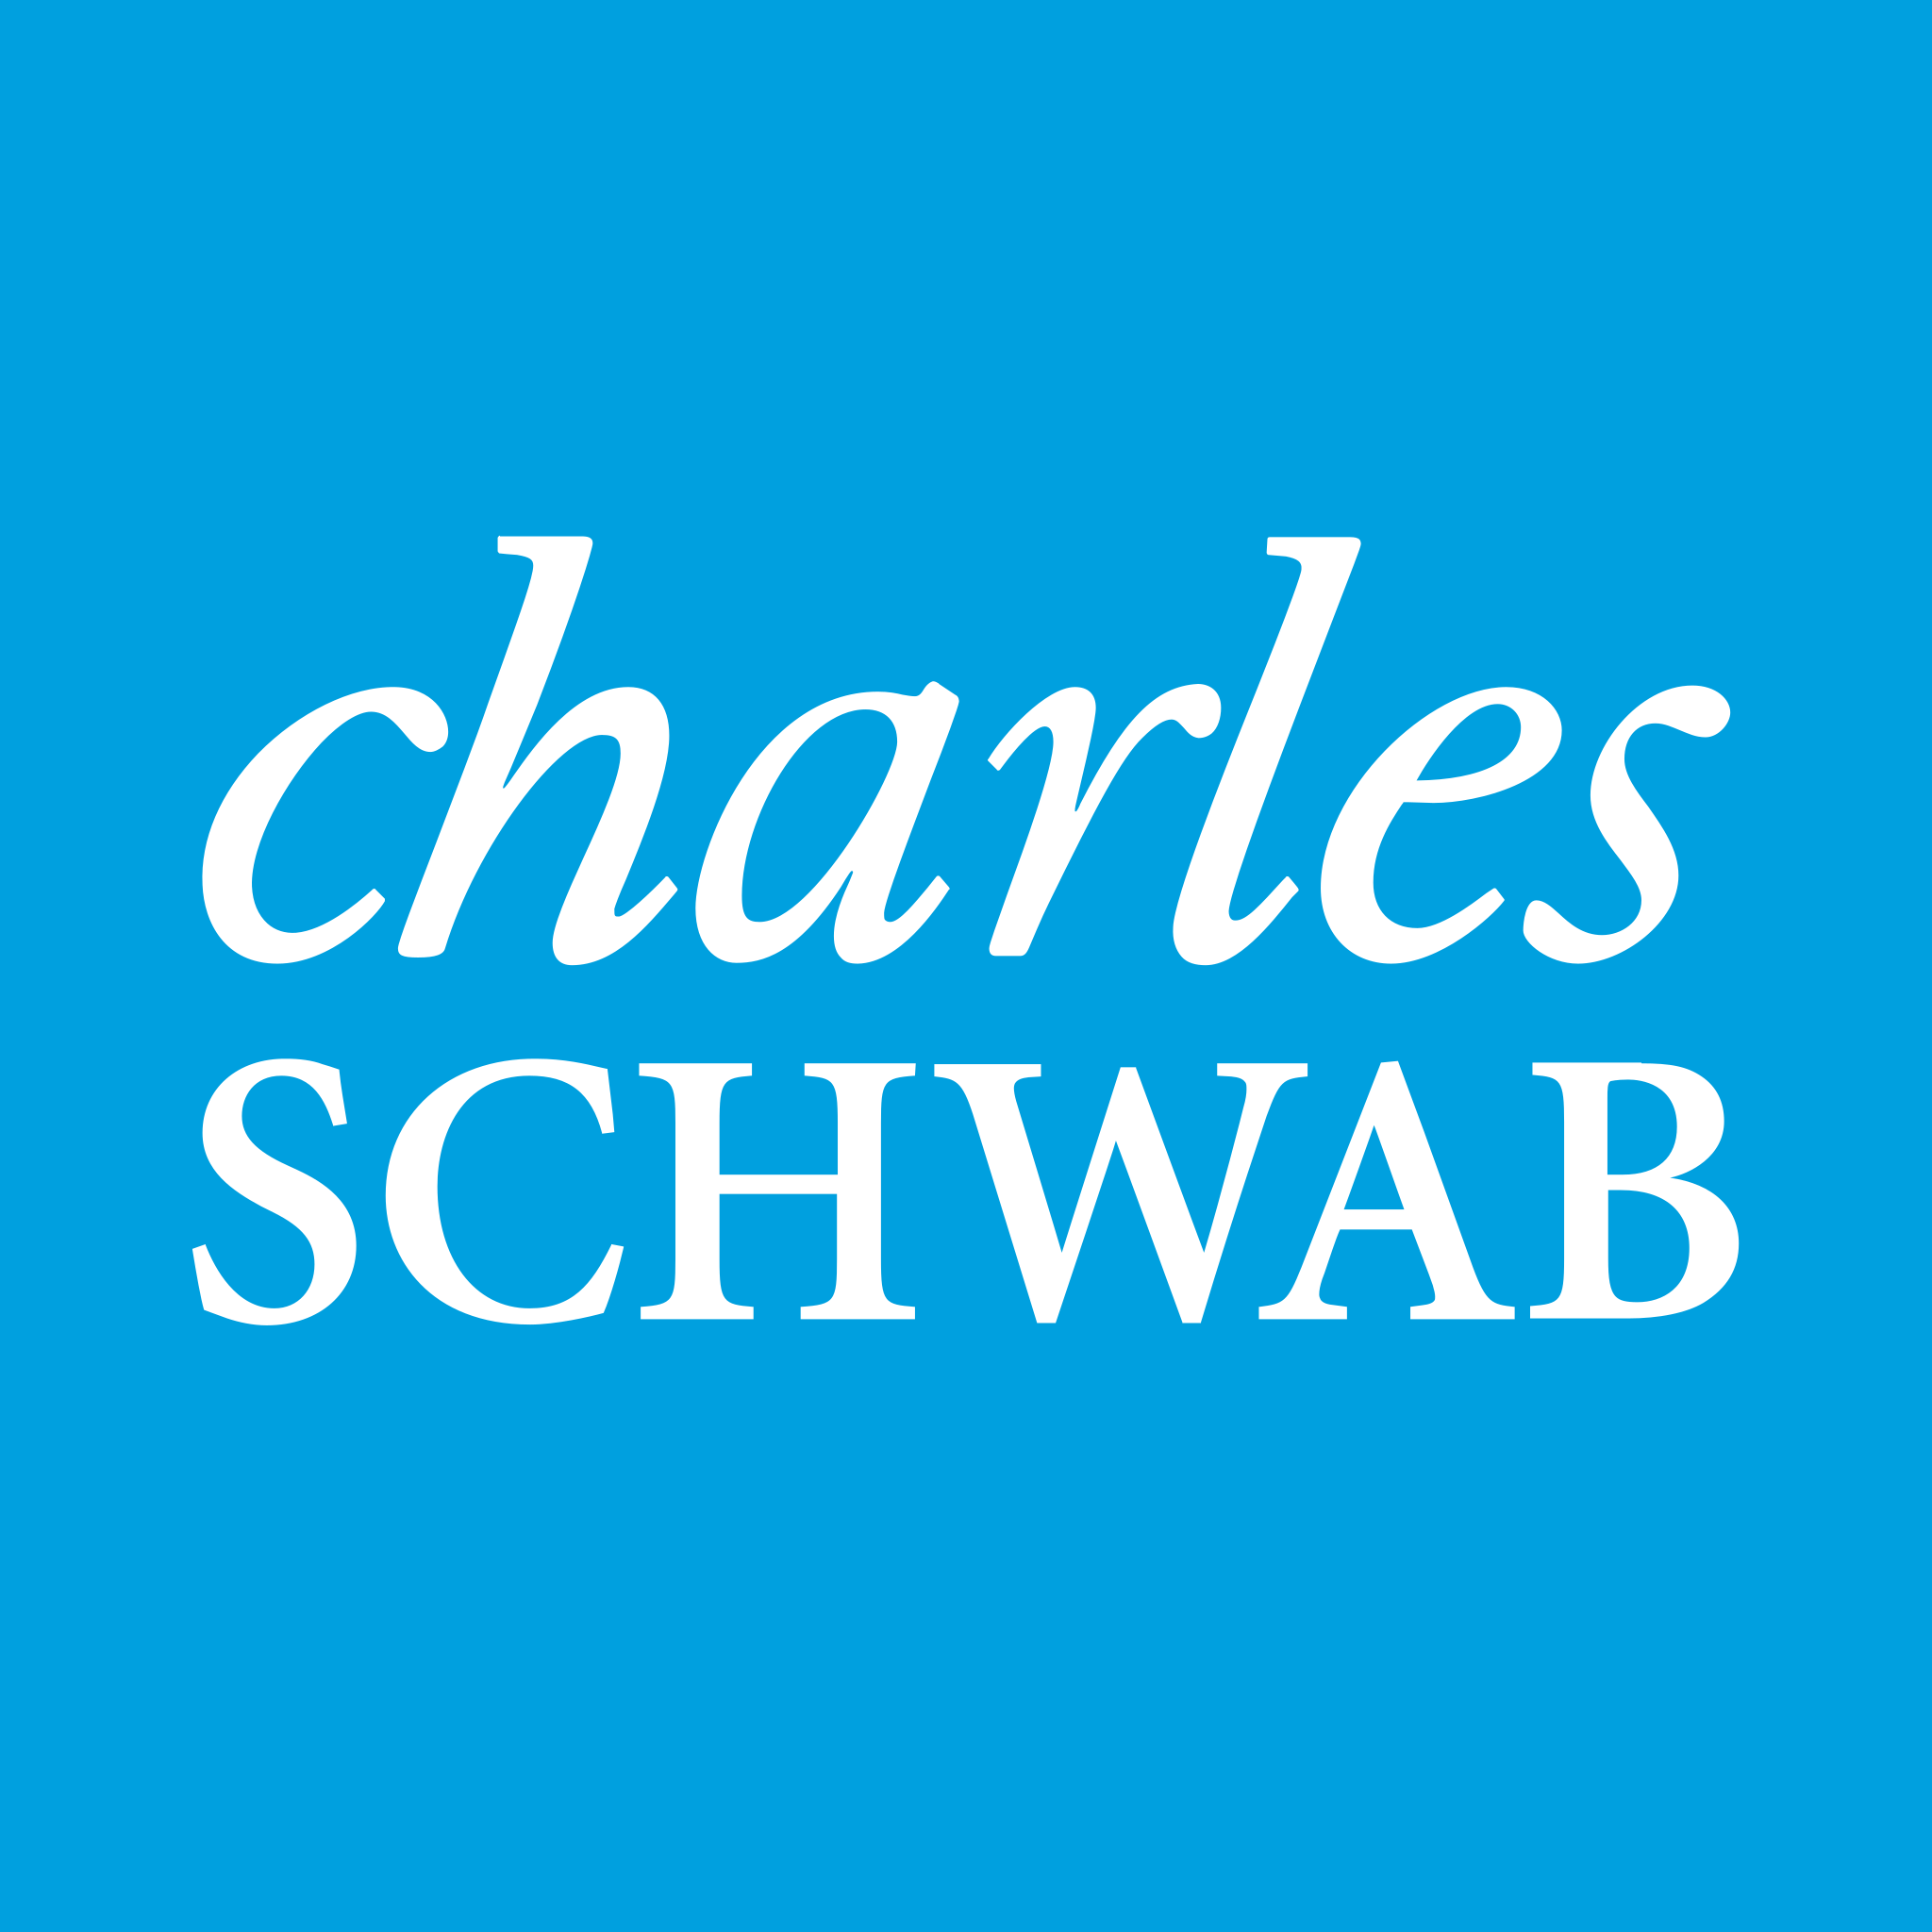


OVERVIEW AND FIRM FACTS
Sequoia Overview
Firm Facts
Our firm was founded in 1991 by our President, Tom Haught. His original vision of a firm that enriches lives endures today.
We bring our extensive resources together for clients to align plans and portfolios with the unique objectives and circumstances of each client family.
Our culture fosters an exceptional employee experience which drives an exceptional client experience.
Our team embodies technical knowledge, values long-term relationships and is empowered to do the right thing for clients.
~$15B AUM
200+ team members
10 offices
10 completed M&A transactions
15% net organic growth
2016-2021
2016-2021
2019
2015-2021

Slide 8
ORGANIZATIONAL STRUCTURE
PRESIDENT & CEO
Thomas Haught
Fairlawn, OH
EXECUTIVE ASSISTANT
Aaron Smith
Senior Associate
Fairlawn, OH
CHIEF OPERATING OFFICER
Joe Glick
Executive Vice President
Fairlawn, OH
CHIEF CLIENT EXPERIENCE OFFICER
Annie McCauley
Executive Vice President
Fairlawn, OH
SENIOR STRATEGIC ADVISOR
Kevin Myeroff
Principal
Mayfield, OH
CHIEF STRATEGY & ACQUISITIONS OFFICER
Kevin Tichnell
Executive Vice President
Fairlawn, OH
CHIEF BRAND & B2B PARTNERSHIPS OFFICER
Open
SITE LEADERSHIP
Kristan Preston
Vice President
Beachwood Site Leader
Mike Orfe
Senior Vice President
Berwyn Site Leader
Matt Pullar
Vice President
Cleveland Site Leader
Heather Walters & Angela Neumann
Columbus Site Leaders
Crissy Antal
Vice President
Fairlawn Site Leader
Tom Neroni
Senior Vice President
Mayfield Site Leader
Kyra Bowden
Director
Tampa Site Leader
Carin Schaffer
Director
Troy Site Leader

Slide 9
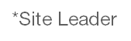
ADVISOR GROUP LEADS
The Advisor Group Lead (AGL) position was created in August of 2021 with the primary goal of aligning advisors’ personal and professional goals with Sequoia’s corporate goals. Today we have five AGLs who manage all the advisors. The AGLs are responsible for ensuring a consistent client and advisor experience across the firm by providing day-to-day coaching and mentoring to a designated group of advisors. Additionally, the AGLs have responsibility for leading organic new revenue growth.
Advisors are assigned to AGLs based on their role, segment of focus/experience and geography.
HEAD OF ADVISORS & BUSINESS DEVELOPMENT
Al Kantra
Executive Vice President
Fairlawn, OH
Al Kantra
Advisor Group Lead
EVP
Fairlawn, OH
Chris Creahan
Advisor Group Lead
SVP
Beachwood, OH
Linda Litner
Advisor Group Lead
SVP
Chicago, IL
John Marchand
Advisor Group Lead
SVP
Fairlawn, OH
Tom Neroni*
Advisor Group Lead
SVP
Mayfield, OH
Mike Orfe*
Advisor Group Lead
SVP
Berwyn, PA
Chris Redhead
Advisor Group Lead SVP
Tampa, FL

Slide 10
ADVISOR GROUP LEADERS – ROLE OVERVIEW
Sequoia’s scalable leadership structure provides a competitive advantage. A differentiating factor is the Advisor Group Leaders (AGLs). These experienced individuals lead advisor recruiting, onboarding, continuous development, sales coaching and service execution across all three client segments. The AGL’s provide the consistency of our “client-first, advisor-driven” approach by keeping decisions being made closest to the client.
Advisor Impacts
Advisor Group Leaders help Advisors:
Engage and apply the resources of the Firm as needed for existing and new client relationships
Evolve the number, source, segment, size and complexity of the clients they acquire and serve in accordance with the advisor’s unique skills, preferences and aspirations
Develop areas of specialization (sourcing new clients, segments, technical or industry expertise)
Resolve issues and realize opportunities when another experienced perspective may be needed
Firm Impacts
Advisor Group Leaders help the Firm:
Develop new and existing distribution channels and business partnerships
Determine segment and new business development strategy
Plan and execute special projects and initiatives
Manage transitions of clients between advisors
Integrate new advisors acquired through M&A activity

Slide 11
ADVISOR GROUP LEADERS – ROLE OVERVIEW
A
G
L
Advocate
Grow
Leverage
For the advisor, individually and as a group with functional departments and Firm leadership
For the Firm’s business model, compensation plans and operating guidelines
Appropriately balance and calibrate the above
By delivering the organic new revenue objectives with advisors
The Advisor Team through recruiting, hiring and onboarding of new advisors
Through professional and personal development of Individual advisors
Firm efficiency, effectiveness and scale through execution of special projects and initiatives
The resources of the Firm
with advisors in delivering the client experience
Best practices across groups, segments and geographies
Technology and business intelligence to turn information into knowledge, and knowledge into action

Slide 12
WEALTH ADVISORS
Sequoia provides its wealth advisors with multiple career-path opportunities through various positions which align with their skill sets and career aspirations. There are three primary wealth advisor roles:
Originating Advisor (OA)
“Sourcing”
Managing Advisor (MA)
“Strategic”
Servicing Advisor (SA)
“Tactical”
The advisor who sourced the new client and initial opportunity
Documented when the household is initially created in Salesforce
Is also the internal referral source or the advisor who received the internal/external referral
Once assigned at relationship acquisition, the originator never changes as subsequent opportunities are identified
Remains on the relationship at least until the prospect has signed the engagement
May stay on as Managing Advisor
Participates in winning new business with the originating advisor
Responsible for developing the relationship plan and strategy
Works with the servicing advisor to ensure an optimal client experience
Issue resolution and opportunity expansion
Segment and distribution channel in part determine initial and ongoing level of direct engagement with the client
Level of direct engagement with the client may change over the life of the relationship, subject to minimum requirements
Day-to-day tactical execution of the client relationship plan
Works collaboratively with the Client Service Associate (CSA) on reactive service requests and proactive service delivery
Ensures that scheduling, meeting preparation and follow up are completed for client reviews and planning
Engages with Managing Advisor with relationship opportunities and concerns
Relationship assessment

Slide 13
TEAM MEMBERS WHO SUPPORT ADVISORS (CONT’D…)
Wealth Management Analyst
(WMA)
Associate Servicing Advisor
(ASA)
Associate Managing Advisor
(AMA)
Sequoia’s Wealth Management Analyst program is a 24-month rotational program designed to train and develop Wealth Advisors. Analysts participate in four 6-month rotations in the following areas:
Client Service
Wealth Planning
Asset Management
Advisor Support
assist with follow-up items to increase capacity for both the SA and MA
The ASA provides support to the Servicing Advisor by servicing smaller, less complex clients. This creates a time dividend which allows the Servicing Advisor to focus on clients with a higher degree of complexity. Additionally, the ASA role frees up capacity for the servicing advisor to take on more relationships.
The AMA provides analytical and project management support for the unique needs of the Managing Advisor. Responsibilities include prospect and custodian advisor follow-up communications and activities, development and preparation of marketing presentation for prospective clients, management of new business data and associated action items within Salesforce, coordination with CSAs, and participation in client prospect calls.

Slide 14
TEAM MEMBERS WHO SUPPORT ADVISORS
Client Service Associate
(CSA)
Wealth Planning Department
(WPD)
Asset Management Department
(AMD)
The client service associate works with advisors to support the day to day needs of our clients. The CSAs handle daily processing of client and advisor requests including new accounts, transfer of assets, money movements, meeting scheduling and preparation.
Our dedicated Wealth Planning professionals work as a unit to craft individual financial plans tailored to our clients’ needs and goals. Our team keeps abreast of the everchanging legislative environment, exploring new and creative ways to help our clients get to where they want to be.
Our Asset Management Department (AMD) constructs centrally managed portfolio strategies and works with our advisors on portfolio transition and construction. AMD holds an internal biweekly call, referred to as Sequoia Markets and Strategy. Your AGL will ensure this is added to your calendar

Slide 15
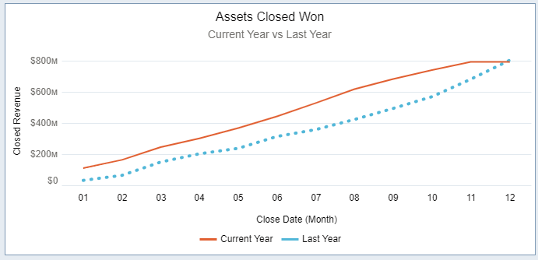
BUSINESS DEVELOPMENT PRACTICES
Sequoia’s organic growth rate is projected to grow at 15% per year. This has been our growth over the past several years and is driven by an unwavering commitment to supporting advisors' continual success. We have an exceptional support team, robust scalable solutions and resources, and six distinct “Distribution Channels” to engage prospective clients.
Considerations
Collaborative, consistent process for participating in new revenue opportunities
Salesforce point-in-time and trend tools to assist in leveraging growth
Continuous advisor development resources to advance practice skills
All advisors have opportunity to gravitate to segments which they are most aligned and enjoy
A “new client sourcing incentive” is available for non advisor employees
Six Distribution Channels
Existing Client Referrals
Cohen and Company (Regional CPA Firm)
Schwab Advisor Network (SAN)
Fidelity Wealth Advisor Solutions (WAS)
Advisor Personal Network
Digital (Website/Online/Zoe)

Slide 16

MULTI-CHANNEL ORGANIC GROWTH ENGINE
B2B Partnership
Growing Existing Client Base with Propensity to Refer
Word-of-mouth referrals from Sequoia’s long-tenured base of households
Advisor Personal Network
COIs and niche end markets cultivated by each of Sequoia’s advisors
Direct Source
Schwab Advisor Network
Joined in 2010; consistent source of pre-qualified client referrals via SAN network
Fidelity Wealth Advisory Solutions
Joined in 2019 and have been ramping across the full Sequoia platform
Diversified Distribution Channels
Cohen & Co.
Top 100 CPA firm where SFG has a 20+ year relationship; bridges tax advice with wealth management
Digital Marketing (Website/ online / SEO / Zoe)
Recent investment in digital marketing drives strong lead generation
Sequoia’s multi-channel client acquisition strategy , supported by its unique B2B partner relationships, propels an advisor’s ability to grow their book

Slide 17
CLIENT SEGMENTATION – SEQUOIA
Financial Advisory
<$2M Net Worth
Private Client
$2-5M Net Worth
Private Wealth
$5-25M Net Worth
Financial Independence
Asset Management (Public)
Insurance
Income Distribution
Comprehensive Planning
Asset Management (Public)
Estate & Gift Planning
Income Tax Planning
Comprehensive Planning
Asset Management (Public & Private)
Estate Planning & Wealth Transfer Strategies
Income & Estate Tax Planning
Sequoia is focused on delivering consistent services across each client segment, creating advisor efficiencies and ensuring a well-tailored client experience

Slide 18
CLIENT SEGMENTATION – SEQUOIA FAMILY WEALTH
Family Wealth
$25M-100M Net Worth
Family Office
>$100M Net Worth
Asset Management (Public & Private)
Estate Planning & Wealth Transfer Strategies
Income, Estate & GST Tax Planning
Trustee Support Services
Consolidated Reporting
Single & Multi-Family Office
Asset Management (Public & Private)
Estate Planning & Wealth Transfer Strategies
Income, Estate & GST Tax Planning
Trustee Support Services
Consolidated Reporting
Sequoia is focused on delivering consistent services across each client segment, creating advisor efficiencies and ensuring a well-tailored client experience

Slide 19
RESOURCE GROUPS
What are Resource Groups?
A forum for you to:
Share your ideas
Connect with other advisors across Sequoia
Shape our messaging and service offerings for each client profile
Adding Resource Groups helps us to expand how we think about client segmentation, to improve how we speak about and deliver services to our clients, and to enhance opportunities to collaborate with one another. As of June 2023, Sequoia offers the following Resource Groups
Business Owners
Executives
Physicians
It is important to note that joining a Resource Group is in no way mandatory. More information on Resource Groups can be found in the “Client Experience” section of the Resource Library

Slide 20
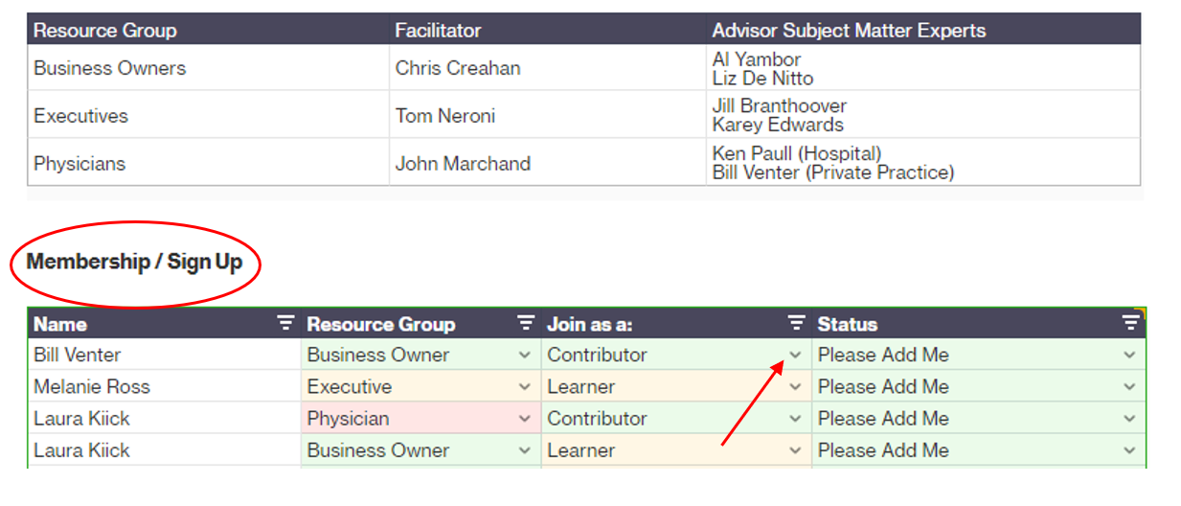
RESOURCE GROUPS cont…
Resource Group Membership
Interested in engaging with one of Sequoia’s Resource Groups? Add your name to the Resource Group Membership Quip document for the opportunity to begin collaborating with other team members and to participate in upcoming discussions with one or more of our Resource Groups .
Join as a contributor or learner

Slide 21





SEGMENT STRATEGY
Built for You.
PROSPECT
SOLUTIONS
WELCOME TO YOUR SEQUOIA
Executive / Accumulator
Business Owner
First Responder
Physician
Retiree
Transitional
Executive Practice Group
Segment Stats
Value Proposition
Profile
Top Tax Bracket
Limited Tax Planning Opportunities
Solution
Tax Efficiency (and Alpha)
Tax Alpha Core
Premier Allocation/ETF
Select Equity/Dividend
Alternatives
SEQUOIA FINANCIAL GROUP
Profile
Executive
Wealth Management
Tax Planning/Prep
Wealthstone Tax
Tyce Tax
Rion Safier Acctg
Berkshire Tax
Cohen & Co
Value Add
Collaboration
Specialization / State & Local
Proactive

Slide 22
SEGMENT STRATEGY UPDATE
Just the Beginning…
Resource Groups
Service Offering & Standards
Brand Strategy & Materials
Organic & Inorganic Growth Strategy
Resources & Analytics
Segment Strategy Leadership Team
Al Kantra
Wealth Management & Financial Advisory
Angela Neumann
Family Wealth
Segment Strategy Objectives
Commitment to all client segments
Alignment of firm strategy with the needs of each segment

Slide 23
COMPREHENSIVE CLIENT SERVICES
Sequoia has a full suite of services to provide clients with wholistic wealth management experience
Basic Finance
Budget
Net Worth
Analysis
Simple Cash Flow
Debt Reduction
Credit
Maximization
Family Financial Literacy
Interface to Generational Planning
Compensation
Paycheck
Maximization
401(k); 403(b); 457(b)
Bonus Distribution
Cash Balance Plans
Non-Qualified Deferred Comp.
ISO Options
NQ SAR
Phantom Stock
Retirement
Social Security Plan
Lump Sum / Pension Analysis
Defined Contribution Plans
Delay / Modify RMD
Social Security Taking Options
Tax Aspects of IRA Beneficiaries
QRPs / Estate Taxes
College Funding
529 Plans
Parent / Child Asset Location FAFSA
FAFSA College Comparison
Splitting Assets
Kids in Family Business
2503(c) Trusts /
NG Trusts
ING’s
Investing
Buy and Hold
Index Funds
ETF Portfolio
Blended Portfolios
Qualified Dividend Capture
Muni Bond Portfolios
Taxable / Tax Deferred Truncation
Alternatives; PE / VC; Opportunity Zone
Risk Management
Basic Insurance Review
Life Insurance Analysis
Choice of Ownership
Intrafamily Risk Management
Trust Protection
IRA Trust
Asset Protections Trust; 831 (b) Captives
Estate Planning
Beneficiary Designation
Will / General Durable Power of Attorney
Revocable Living Trust
Dual Trusts
ILIT / Family LLC
Internationally Defective Grantor Trust
Advanced Trusts
Tax Planning
Deduction
Management
Bracket Maximization
Family Business Planning
Roth Conversion
Family Roth Use
Business Planning; 199A / 168(k); OL / C Corp.
Generational Bracket Splitting; Estate Taxes
Life Issues
Attitudes About Money
Elder Planning
Generational Education
Family Money Values
Interface of Family Wealth and Charitable Intent
Problem Family Members
Family Wealth Management Succession
Charitable Intent
Cash Gifts
Bracket Squeeze
Appreciated Property
Donor Advised Funds
Charitable Annuity / Remainder Trust
Charitable Lead Trust
Private Foundation; Life Insurance

Slide 24
Wealth Planning

Slide 25
DEPARTMENT OVERVIEW
The Wealth Planning Team provides technical leadership along with comprehensive and modular financial modeling, with defined processes and deliverables for each of our three client segments.
Wealth Planning Team
Department Chair | Heather Welsh, CFP®, AEP®, MSFS
Wealth Strategist | Will Gandert, CFP®, RICP® Tina Malek, CPA Daniela Truver, CFP ®, CTFA
Wealth Planners | Mike Spangler, AWMA® Daniel Tesfaye, CFP ® Jamie Wiggins Michael Daniels, AWMA®
New Plans, Updates or Modular Projections | TTM average of 99.4 case requests each month
Strengths
Strong, Tenured Leadership
Depth of Technical Excellence
Current Initiatives
Interactive Planning

Slide 26
WEALTH PLANNING SUPPORT
Our commitment to planning spans the client lifecycle.
1
2
3
Prospects
Onboarding
Clients
Planning observations
Prospect meeting support (PW/FW)
Modular analysis – speed to value
Initial plan creation
Identification of key implementation items based on client priorities
Plan monitoring & updates
Communication of segmentation-based planning opportunities
Ongoing thought leadership

Slide 27
WEALTH STRATEGIST
What is a Wealth Strategist?
We are an extension of the client service team who can act as a subject matter expert on business succession planning, advanced executive compensation and UHNW estate planning.
Wealth Strategist (Example Case)
Client Type
Net worth in the $5 million+ range
One off case where advisors are looking for thought partnership of a specific topic (complex trust, RSUs/Stock Options, etc.)
Level of engagement
Review of specific materials for client/prospect meeting
Limited to the scope of this topic and no go forward client engagement
Can be part of the call with client/prospect or in the background working with the advisor

Slide 28
WEALTH PLANNING SOLUTIONS BY SEGMENT
Segment-based solutions tailored to each client’s specific needs.
 |  | Sequoia |  |  | Sequoia Family Wealth
 | Central Accounts | Financial Advisory | Private Client | Private Wealth | Family Wealth | Family Office
In-House Solutions | <$400k | $400k | $1.5m | $4.3m | $50m
Financial Independence Planning
Tax Planning
Estate Planning
Wealth Transfer & Philanthropic Strategies
Trustee Support Services
Business Succession Planning
Third Party Solutions
Tax Preparation
Legal Document Preparation
Corporate Trustee Solutions
Risk Management & Insurance
Retirement Plan Services
We harness the power of specialization. Our clients deserve to work with a collaborative team of specialists who love what they do. We pair our in-house resources with a curated menu of institutionalized relationships to meet our clients needs across the wealth spectrum.
28

Slide 29

RISK MANAGEMENT / INSURANCE SOLUTIONS
Highest level of expertise and scale in the increasingly complex insurance industry through Long Road Risk Management.
Insurance Philosophy
Planning-first approach & ongoing commitment to monitor & manage in-force policies
Over 700 Policy Management Company-managed policies
Expertise
Trusted insurance advisor specialists
Savvy underwriters
Concierge application & new business specialists
Experienced policy management team
Detail-oriented service associates
Scale
Dedicated insurance support team
Access to more insurance specialists to cover growing footprint
Leverage advisor capacity to focus on client experience
Technology & Processes

Slide 30
ESTATE PLANNING & TRUST SERVICES SOLUTIONS
Estate Document Preparation
Financial Advisor & Wealth Management
Integrated legal services provided through Stavale & Gemmete to approximately 1,000 households
Exploring technology-enabled solutions
Family Wealth
Broad network of specialized estate planners for complex service needs
Trust Support Services
Administrative-Only Corporate Trustees
Clients often want Sequoia to be the investment manager, but may need a corporate trustee who will partner with us and be willing to serve as trustee when the assets are custodied at Schwab or Fidelity.
Sequoia In-House Trustee Support Services
Family members, friends, and professional advisors are often asked to serve as trustees of our client’s trusts. Using the unique reporting capabilities at Schwab and Fidelity and the consultative approach we take in supporting trustees, we are prepared to help them perform their duties efficiently and professionally.
*Accounting & compliance components are prepared by a third party

Slide 31

RETIREMENT PLAN SOLUTIONS
CBIZ retirement plan specialists pair personalized service with nationwide talent.
Services
Plan design & documents
Participant services
Consulting
Third Party Administration
Actuarial (DB plans)
Valuation (ESOPs)
Expertise
Deep bench of specialists who deal solely with varied retirement plan nuances
Technical updates for Sequoia advisors facilitate knowledge to introduce retirement plan discussions
Scale
National footprint (400+ professionals; 25+ offices)
International capabilities
Advisory services to ~125 Sequoia plans*
*Excludes non-advisory services such as TPA work & actuarial services for CBPs

Slide 32
TAX PLANNING & COMPLIANCE SOLUTIONS
 |  | Sequoia |  |  | Sequoia Family Wealth
 | Central Accounts | Financial Advisory | Private Client | Private Wealth | Family Wealth | Family Office
In-House Solutions | <$400k | $400k | $1.5m | $4.3m | $50m
Holistiplan
Curated Relationships (1,500 HH)
Tyce Tax Services
Rion Safier Accounting
Berkshire Tax Group, Inc.
Wealthstone Tax Advisors
Cohen & Company

Slide 33
HOLISTIPLAN
What is Holistiplan?
Comprehensive tax analysis software that can provide immediate insight into your client's income, deductions and held away assets.
Tax Analysis Report
Quickly understand where your client lies within the tax brackets
Bracket topping strategies
See where dividends and interest are coming from
Where are accounts held away
See how much if any carry over loss a client has.
Provides insight on how reallocating portfolios will affect capital gains taxes
Ability to reduce exposure from highly concentrated positions
Additional Features
Scenario Analysis
Tax Explainer
Qualified Charitable Distributions (QCD) Report
Donor Advised Fund (DAF) Report
Training Materials
Sample

Slide 34
TURNKEYS AND fpPATHFINDER
Turnkeys & fpPATHFINDER
What are turnkeys?
Resource Library of WPD-created papers on relevant planning topics
Examples: Social Security, Estate Planning, Roth Conversions, and many more
WPD continuously is creating new turnkeys based on advisor recommendations and industry trends
What is fpPATHFINDER?
External resource for flowcharts and checklists which may be downloaded and delivered with Sequoia branding
Can be used to quickly illustrate a topic and great to use along side our turnkeys
Linked to Holistiplan (should a relevant topic be identified)

Slide 35
Asset Management (AMD)

Slide 36
INTEGRATED PLANNING & ASSET MANAGEMENT
+
Financial Planning
Investment Management
Sequoia offers comprehensive wealth planning services, including retirement, estate, tax, philanthropy, and business succession planning.
A dedicated, centralized planning team supports Advisors and serves all client wealth segments. The Wealth Planning Team provides technical leadership along with comprehensive and modular financial modeling, with defined processes and deliverables
Sequoia’s investment management team specializes in top-tier public and private market investment solutions.
Investment objective is to outperform strategy benchmarks, net of fees, on an absolute and risk-adjusted basis over a full market cycle.
Full menu of SMAs, equity, fixed income, and alternative assets (private equity, private credit, real estate, hedge funds).
Sequoia takes a long-term investment approach, focused on data-driven investment decisions that balance fundamental valuation and risk

Slide 37
PORTFOLIO STRATEGIST
What is a Portfolio Strategist?
A Sequoia Team member that has an extensive background working within the asset management framework, analyzing and constructing client portfolios, and keeping abreast of economic and financial market conditions.
Portfolio Strategist (Case)
Client Type
Most likely Financial Advisory or Wealth Management
One off case where advisors are looking for partnership to think through portfolio review / recommendation
Level of engagement
Review of specific materials for client/prospect meeting
Limited to the scope of this topic and no go forward client engagement
Likely behind the scenes, as thought partner for the advisor

Slide 38
AMD ORGANIZATIONAL STRUCTURE
ASSET MANAGEMENT
Annie McCauley
Executive Vice President
Fairlawn, OH
INVESTMENT POLICY COMMITTEE CHAIR (INTERIM)
Ed Antoian
Principal & Senior Strategic Advisor
Berwyn, PA
ASSET MANAGEMENT OPERATIONS
Mike Mordoh
Senior Director
Columbus, OH
CHIEF INVESTMENT STRATEGIST/ ALTERNATIVE INVESTMENTS
Jack Zhang
Vice President
Austin, TX
PORTFOLIO MANAGER
David Choi
Vice President
Berwyn, PA
CHIEF INVESTMENT OFFICER*
Nick Zamparelli
Senior Vice President
Berwyn, PA
OPERATIONS ANALYST
Christina Arnault
Associate Director
Berwyn, PA
OPERATIONS ANALYST
Valerie Jones
Associate Director
Columbus, OH
PORTFOLIO ANALYST
Tom Moughan
Senior Director
Beachwood, OH
OPERATIONS ANALYST
Paul Riley
Associate Director
Berwyn, PA
PORFOLIO ANALYST
Angela Thorn
Senior Associate
Mayfield, OH
INVESTMENT OPS GROUP LEAD
Richelle Durkin
Director
Troy, MI
RESEARCH ANALYST
Nick DeFlorian
Director
Berwyn, PA
RESEARCH ANALYST
Brian Wright
Associate Director
Berwyn, PA
PORTFOLIO MANAGER
Joe Bodnar
Director
Berwyn, PA
RESEARCH ANALYST
Jim Durkin
Associate Director
Berwyn, PA
HEAD OF REAL ESTATE Tom Farrell
Vice President
Berwyn, PA
HEAD OF MANAGER RESEARCH
BJ Hargadon
Vice President
Berwyn, PA
HEAD OF PRIVATE EQUITY
John Kemmerer
Vice President
Berwyn, PA
HEAD OF FIXED INCOME
Kevin O’Shea
Vice President
Berwyn, PA
RESEARCH ANALYST Vishal Patel
Director
Berwyn, PA
PORTFOLIO MANAGER
Les Globits
Vice President
Mayfield Heights, OH
RESEARCH ANALYST
Henry On
Director
Fairlawn, OH
INVESTMENT OPS ANALYST
Shane Bobbitt
Senior Associate
Columbus, OH
INVESTMENT OPS ANALYST
Brian Petras
Senior Associate
Troy, MI
INVESTMENT OPS ANALYST
Andy Brophy
Associate
Troy, MI
*CIO of ZCA, a part of Sequoia Financial Group

Slide 39
PORTFOLIO SOULTIONS BY SEGMENT
Taxable
Tax-Exempt
Satellite Solutions
Family Wealth
Sequoia Tax Alpha Core
Fixed Income SMA and/or Fund Model
Alternative Investments*
Multi-factor
Alternative Investments*
Custom solutions are only for clients with exceptional circumstances and should not be used as a default solution
For those that require active single stock management, SSE/SSD are options
SFG offers ESG solutions through various partners
SFG has multiple options to deal with concentrated positions
Private Wealth
Sequoia Tax Alpha Core
Fixed Income SMA and/or Mutual Fund Model
Alternative Investments*
Multi-factor
Alternative Investments*
Private Client
Sequoia Premier Allocation
ETF Models
Sequoia Premier Allocation
ETF Models
Financial Advisory
Sequoia Premier Allocation
ETF Models
Sequoia Premier Allocation
ETF Models
*Alternative investments are available to clients with $2.5M+ AUM with SFG and have the ability and willingness to tolerate alts risk
Note there are no model changes required for legacy clients other than continued migration towards being on model.

Slide 40
INVESTMENT PRINCIPLES
1
2
Fundamental Valuation
Long-Term Investing
We invest with long-term time horizons, not speculating on short-term moves.
We look for investments that have the potential to compound over time.
3
4
Data-Driven
Risk Management
We use data and evidence over “gut feel” when making investment decisions.
We strive to take the appropriate level of risk per expected return.

Slide 41
VIDEOS FOR CORE STRATEGIES
Portfolio Strategies by Segment (Video)
Slides
AMD Philosophy and Principles (Video)
Slides
Strategy Portals Main gateway listing up to date model weightings, attribution, trade rationale and quarterly commentary
Premier Allocation Strategies (SPA) Portal
Sequoia Select Equity (SSE) Portal
Sequoia Select Dividend (SSD) Portal
Tax Alpha (STAC & TAE) and Multi-Factor Portal

Slide 42
Compliance

Slide 43
COMPLIANCE ORGANIZATIONAL CHART
CHIEF COMPLIANCE OFFICER
Matt Dunn
Vice President Fairlawn, OH
SENIOR COMPLIANCE MANAGER
Kelly Russell
Vice President Mayfield, OH
COMPLIANCE SPECIALIST
Tracy Nida
Director Akron, OH
COMPLIANCE SPECIALIST
Marcy Bahr
Senior Associate Mayfield, OH

Slide 44
WHAT DOES COMPLIANCE DO?
Compliance has two jobs, and they are prioritized:
Protect the advisor
Protect Sequoia
What risks are they protecting?
Client Complaints / Arbitration
Regulatory Sweeps / Exams
How do they protect us?
Review applicable rules
Set firm policy
Training
Follow up ensure policy is followed

Slide 45
Marketing

Slide 46
Marketing and Communications
All strategic and coordinated marketing efforts are organized into one of two buckets: enterprise marketing and advisor support marketing. Through exploration, creation, and implementation, we build plans and processes to delivery value and help Sequoia gain a competitive advantage.

Slide 47
MARKETING ORGANIZATIONAL CHART
HEAD OF ADVISORS & BUSINESS DEVELOPMENT
Al Kantra
Executive Vice President
Fairlawn, OH
CMO (Interim)
Nick Richtsmeier
CultureCraft CEO
Des Moines, IA
DIGITAL MARKETING SPECIALIST
Ruthie Casey
Associate Director
Chicago, IL
DIRECTOR OF MARKETING (Interim)
Katie Luckashow
CultureCraft Chief of Staff
MARKETING COMMUNICATIONS SPECIALIST
Britt Metzner
Associate Director
Troy, MI
MARKETING SPECIALIST
Meg Murphy
Associate Director
Beachwood, OH
MARKETING SPECIALIST
Tracie Varvir
Senior Associate
Fairlawn, OH

Slide 48
Thought Leadership Committee
The Thought Leadership Committee exists to assist marketing in determining our approach to the creation and distribution of thought leadership on financial planning, investments, market and geo-political conditions.
The objective is to ensure the content, format and frequency of our communications represents a unified Sequoia voice, with messaging appropriately tailored and curated for the separate and distinct profiles of our audiences.
Guides marketing in the creation of content and delivery of thought leadership materials for our team
Assists in development and execution of our communication strategy with clients, prospects, COIs and social media
Serves as a clearinghouse for communication ideas from across the firm
Seeks to bring organization, consistency, and alignment to our thought leadership approach
Works to Improve and increase the audience for and impact of our materials and communications in support of our brand and our efforts to acquire, retain and grow client relationships
Diverse membership includes representatives of functions, segments, advisors, distribution channels, and geographies.
SEQUOIA FINANCIAL GROUP

Slide 49
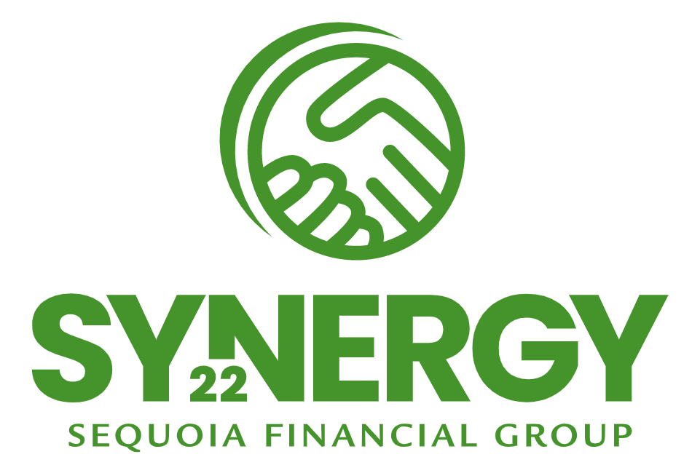
Sequoia Synergy
Synergy is an annual, firm-wide event for all team-members to get out of the office and meet up somewhere new to regroup, recharge, build camaraderie, and plan for the future. This company retreat is typically held in Northeast Ohio in late summer or early fall and consists of two full days of programming. Don’t worry, prime nightlife is a top requirement when choosing the location and venue! Synergy has become a big hit internally and always aims to:
Strengthen professional connections
Encourage creativity
Spark excitement
Foster innovation
Boost morale
Build Sequoia pride
SEQUOIA FINANCIAL GROUP

Slide 50
Building Opportunities

Slide 51
ROLES WHEN BUILDING HOUSEHOLDS AND OPPORTUNITIES
Internal Referrer - Can be any Sequoia employee who introduces a new relationship or opportunity to Sequoia, regardless of position. This person can be the same or different than the Originating Advisor. Internal referrer is identified on BOTH the household and each opportunity. Household level internal referrers should not change. Individual opportunities can be referred by anybody in the firm
External Referrer – The person, outside of Sequoia, who provided the opportunity to Sequoia. Can be an existing client, Cohen employee, another COI or person from your personal network, or a Fidelity or Schwab representative. Opportunities may have both an internal and external referrer.
Household: Originating Advisor - This is the advisor (managing or servicing) who sourced the initial household opportunity and is also the internal referral source or the advisor who received the internal/external referral. Once assigned at relationship acquisition, the originator never changes on the household or on subsequent opportunities when identified.
Opportunity Owner - This is the advisor primarily responsible for advancing the sales process and closing the opportunity. The system automatically inserts the name of the person entering the opportunity; however, the owner can be changed after the opportunity is initially built and saved.
Managing Advisor - Segmentation drives ongoing level of engagement with the Servicing Advisor and client. The Managing Advisor provides strategic advice and relationship oversight. The Managing Advisor has overall responsibility for relationship strategy and, if they are not also the servicing advisor, working in concert with the servicing advisor to ensure an optimal client experience.
Servicing Advisor - Segmentation drives the ongoing level of engagement with the Managing Advisor and client. The Servicing Advisor is the advisor who implements strategy and provides the client with tactical advice and ongoing service.

Slide 52
OPPORTUNITY TYPES
Build and Update Opportunities in Salesforce for:
Financial planning or project-based fee cases where a separate planning/project fee is being earned
New client asset-based fee opportunities
Existing client asset-based fee opportunities of $100,000 or more
Recurring retainer fee opportunities
Fee increases or discount reductions where $1,000 or more of additional annualized revenue will be earned. Build the opportunity for only the increase amount. Status as “Signed” when the client has agreed to it. Move to “Closed Won” on the day the fee increase will be in effect (usually the first day of the next quarter)
Long Road Risk Management opportunities
CBIZ retirement plan or institutional asset management opportunities
Q: Who should build and update opportunities? A: If not otherwise agreed upon by the service team on the household, the Sequoia team member who is noted as the internal (Sequoia) referral source of the opportunity OR the person who will remain the opportunity owner in Salesforce should build it and update it through close

Slide 53
OPPORTUNITY UPDATING AND ADMINISTRATION
Updates After Closing - Opportunities cannot be updated by advisors or CSAs once moved to closed won status. This requires updating of initial funding AUM, estimated revenue and other data prior to advancing the stage to closed won. Sequoia Tech Team can still make changes after opportunities are advanced to closed won; however, this should be on an exception basis rather than a regular occurrence. A miscellaneous tech case should be created and submitted to facilitate adjustments (after closed won status)
AUM and Fee Amounts - Estimated or expected AUM amounts and fees should be entered when opportunities are initially created. Before closing them on the system, opportunities must be updated to actual asset value received and estimated fees based on the fee schedule applied
Back-Dating of Close Dates - The system does not permit back-dating of close dates prior to opportunity create dates
External Referral Source Names - If the distribution channel selected is Cohen, existing client relationship, or advisor personal network, the external referrer name is a required field
Opportunity Ratings - The “Hot/Warm/Cold” rating is the primary means of noting the probability/urgency/timing of the opportunity and should be updated throughout the sales cycle
Next Action Date - This field was been added to log the date of your next intended contact with or action on the opportunity. This populates with a date one week from creation if not overwritten with a different date
Signed Status - “Signed” was added as a new opportunity stage in Salesforce to enable better new revenue forecasting. Please move opportunities to this stage when the client or prospect has committed and related documents have been signed

Slide 54
Important Facts for New Advisors

Slide 55
PERSONAL DEVELOPMENT AND CHECK-INS
COMMUNICATION IS KEY
You will have multiple check-ins throughout each quarter with your AGL
On a more formal basis, you will have a mid-year and year-end review with your AGL
Your AGL will walk you through how to complete your formal self-assessment in a Performance Plan template in Quip
You can access the Performance Plan template here to create a new one.
Once your self-assessment is complete, please notify your manager with a comment through the Quip document.
Your Manager will complete their assessment and then will schedule a Performance Review meeting with you.
After the Performance Review conversation is complete, you need to complete the Acknowledgement step and notify your manager this is complete.
For more information, CLICK HERE

Slide 56




DISTRIBUTION CHANNELS
Sequoia has enjoyed a 20+ year collaborative relationship with Cohen & Company, an accounting firm whose mission is to improve the lives of others by providing top-tier tax, assurance and advisory services. They serve a broad range of clients, from privately held companies and their owners; to public and private funds, advisers and fund service providers within the investment industry; to Fortune 1000 multinational enterprises.
Sequoia is one of approximately 200 pre-screened financial advisors working with Charles Schwab Financial Consultants to offer additional services across a broad range of specialties including investment management, financial planning, insurance, tax strategies, and estate planning, depending on a client’s specialized needs.
Fidelity offers the WAS referral network option for wealth management clients whose strategies might benefit from additional, specialized services. Sequoia is part of an elite group of less than 100 firms within their referral network of independent, registered investment advisor firms.
Sequoia is heavily involved in our local EO group, offering insight and collaborative service tailored to the specialized needs of entrepreneurs. We understand the reality of business owners’ lives, and we’re focused on providing customized solutions to help them maximize their business’ impact in the present and take them into the future.

Slide 57
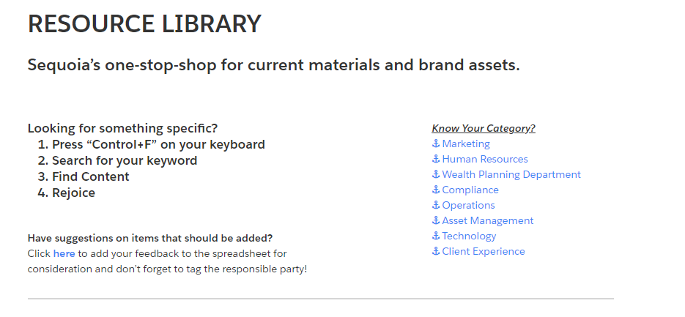

RESOURCE LIBRARY
THE RESOURCE LIBRARY
When in doubt, search the Resource Library. Think of it as the internal “Google” of Sequoia. The Resource Library can be found at the link below, or by searching in Quip.
Click HERE for the Resource Library

Slide 58
SEQUOIA GIVES BACK
Sequoia believes in giving back and we encourage everyone in our organization to get involved in their local communities and in other charitable causes to share your time, talents, and treasures.
In 2015, Sequoia began a match program where we will match dollar for dollar contributions you make to a 501(c)(3) corporation, with a maximum match amount based on years of service.
Eligibility for the match begins the month following your hire month.
For those serving up to 5 years at Sequoia, we will match up to $200/year; 6-10 years of service will be matched up to $400/year; and 10+ years of service will be matched up to $600/year.
Ex: if you are in your 7th year with Sequoia and contribute $400 or more to a qualified charitable organization, Sequoia will match the $400.
A qualifying donation:
Must be approved by Sequoia, in line with our vision (to enhance lives) and values (integrity, passion, teamwork).
Will be no less than $50, with a maximum of 4 matching requests per year per person (no matter the length of service).
To submit a request for a matching donation, please complete this FORM (Click USE TEMPLATE button) including the attachment of a receipt regarding your charitable contribution. Instructions are on the form to share it with Jodi Burgy for processing.

Slide 59



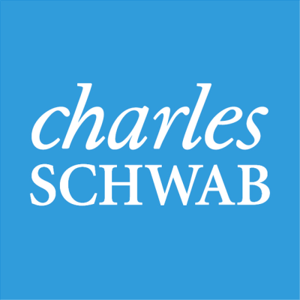


















OUR TECH PLATFORM
Integrated Advisor Portal and Tools
Integrated Client Portal
Advisor Training
Sequoia Financial Group Technology Platform
Custodial Integration
Client Experience
Productivity
Organizational Apps
SFG integrates with its two primary custodians to provide advisors with efficient access to relevant information
Cash flow-based projections and analysis
CRM system; helps boost productivity, optimize operations, builds apps fast and helps advisors work smarter with a deeply integrated 360 degree relationship view
Builds relationships while leveraging personalized data to drive client acquisition and retain / grow AUM
Social security timing analysis
Comprehensive client and business intelligence solutions that offer analytics to help grow and manage business
Data gathering for new clients
Connects user email with Salesforce customer data, tracking emails and gaining communication insights with clients and prospects
Enables advisors to run their business with greater efficiency, scale and profitability
Customized content specific to training team members on using SFG’s tech stack and processes
Combines documents, spreadsheets, chat and slides into a collaboration platform that integrates with Salesforce
Simplifies back-office workflows with robust and flexible online accounting software
Provides daily balance and historical client account performance insights; storage of quarterly statements and facilitation of document transfer
Integrated and secure cloud document storage; facilitates client data sharing and internal collaboration
Automated expense reporting
AI automation technology
Digital library of custodial forms mapped to Salesforce data
WealthTech cloud architecture and system optimization
Proposal generation and tracking technology
Esignature capture and delivery
Data aggregation, visualization and reporting
Connects potential clients with advisors
Sequoia uses personalization of applications at scale to provide the right integrated solutions each facet of the advisor role

Slide 60
CONCUR - EXPENSE GUIDELINES
The expectations of employees:
Behave honestly, responsibly and within the guidelines of this policy
Seek to keep costs to a minimum where possible in line with the best interests of the business
Submit expenses as soon as possible after they have been incurred
Provide sufficient details to explain why you’ve made the purchase and any supplementary details, e.g. if you paid for other employees
Submit all receipts because the IRS requires them
All expenses and receipts will be submitted via the Concur system (https://www.concursolutions.com). See the Training Page in Salesforce for detailed instructions on the expense submission process
Must comply with the Sequoia Financial Group Compliance Manual (Compliance Manual), see Compliance page on the Firm intranet.
For more information, please see the “Expense and Travel Reporting” section of the Employee Handbook

Slide 61

FLEXIBLE WORK ARRANGEMENTS
Flexible Work Policy
If you would like to take advantage of Sequoia’s flexible work arrangement, you can request a flex work arrangement by emailing HR@sequoia-financial.com. HR will send a DocuSign you and your manager to complete. Please note that all flexible work arrangements are required to be approved by our manager before they become effective.

Slide 62
Our Capital Partners

Slide 63
60% EMPLOYEE OWNED
Act like an owner, because one day you might be one!

Slide 64

ABOUT KUDU INVESTMENT MANAGEMENT
Kudu provides asset and wealth managers worldwide with permanent capital solutions tailored to their specific needs, including: ownership transfer, partner liquidity, management buyouts, and acquisition/growth finance. Kudu also offers a range of business services to help its partners expand while remaining independent.
Kudu’s capital partner is White Mountains Insurance Group, Ltd. (NYSE: WTM)

Slide 65

ABOUT VALEAS CAPITAL PARTNERS
Valeas Capital Partners is a San Francisco based private equity firm focused on partnering with the most accomplished and innovative Founders and CEOs to develop compelling, growth oriented, and often technology enabled companies in the financial services, healthcare, consumer and data & technology industries.
Valeas was founded by former Hellman & Friedman professionals, Rob Little and Ed Woiteshek, who have more than two decades of experience successfully operating and investing in North American middle market businesses.
The firm is backed by current and former Hellman & Friedman partners as well as an extensive network of successful Founders & CEOs with whom Rob and Ed have worked closely.
Sequoia will be Valeas' cornerstone U.S. wealth management investment.

Slide 66
Vision 2030

Slide 67
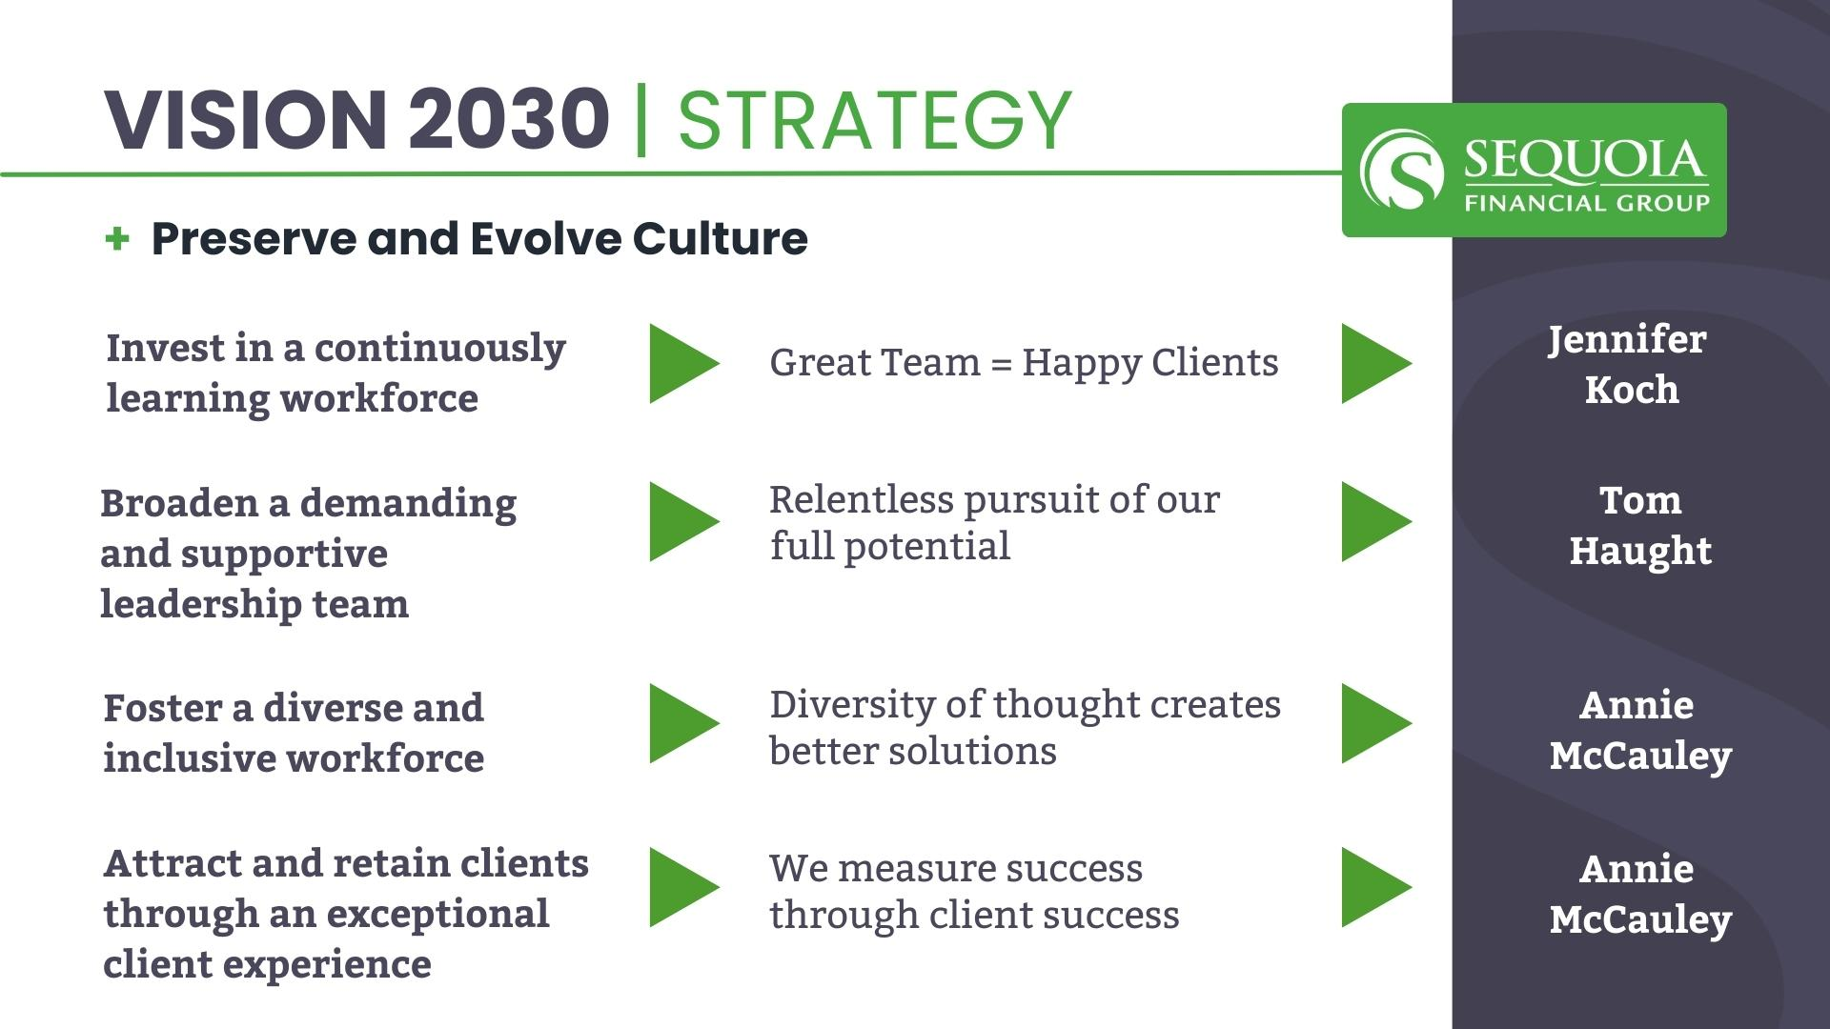

Slide 68
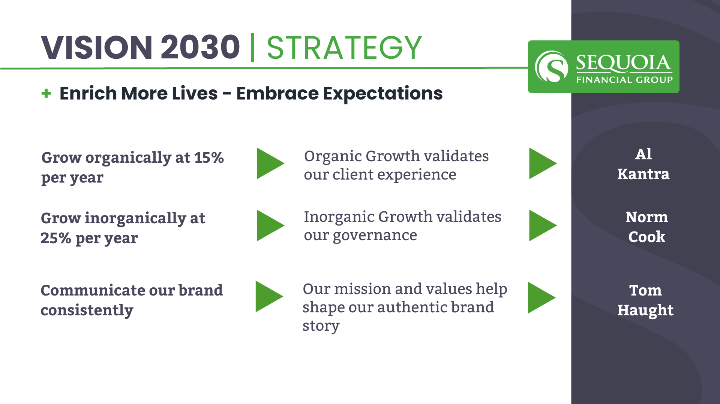

Slide 69
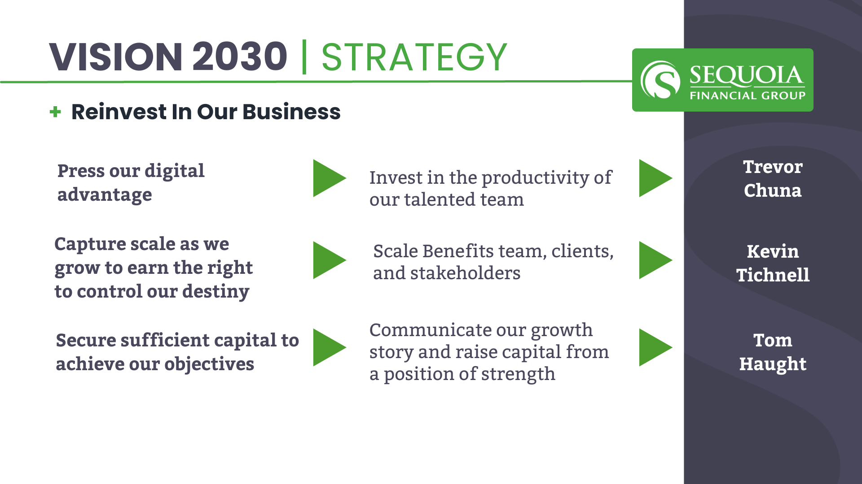

Slide 70
We are excited you are here. Welcome aboard!

